Slide 1


Network Intrusion Detection
Capt Jacob Lang
1Lt Brandon Hosley
1Lt Matthew Sauer
Mr. Gregory Buchanan
The views expressed in this presentation are those of the author(s) and do not reflect the official policy or position of the United States Air Force, the Department of Defense, or the United States Government.

Slide 2
Overview
Motivation
Dataset
Factor Analysis
XGBoost
Neural Net
Naive Bayes
K-Nearest Neighbors
Cross Validated Logistic Regression
Results
Conclusion
Questions

Slide 3
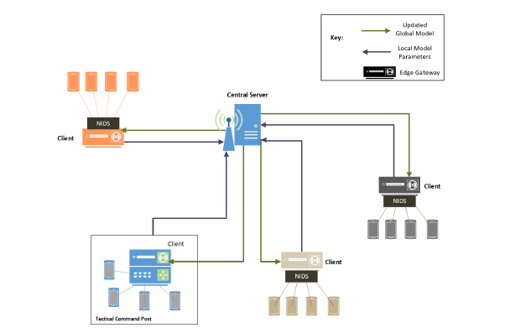
Motivation of Research
Intrusion Detection is vitally important for cyber security
Lackluster detection systems will leave the whole DoD vulnerable to adversaries
Network attacks are rapidly evolving and growing in sophistication
This necessitates systems that can rapidly adapt and develop to new attacks with less data

Slide 4
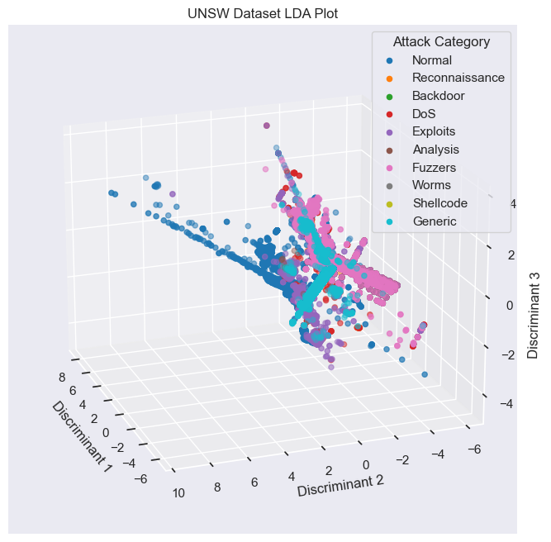
UNSW-15B
47 features with 175,545 samples
Nine attack types:
Normal(56000)
Generic(40000)
Exploits(33393)
Fuzzers (18184)
DoS (12264)
Reconnaissance (10491)
Analysis (2000)
Shellcode (1133)
Worms (130)

Slide 5
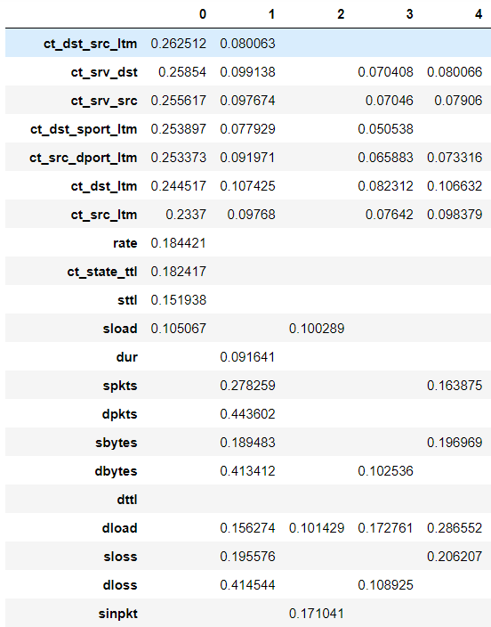
Factor Analysis
Dropped values less the 0.05 influence with three factors
Factor 1: Size of packet, outbound frequency
Factor 2: Frequency of dropped packets, size of outbound packets
Factor 3: Fuzzing and network enumeration like behavior
Factor 4: Factor 1 but focused on TCP
Factor 5: Factor 1 but focused on FTP

Slide 6
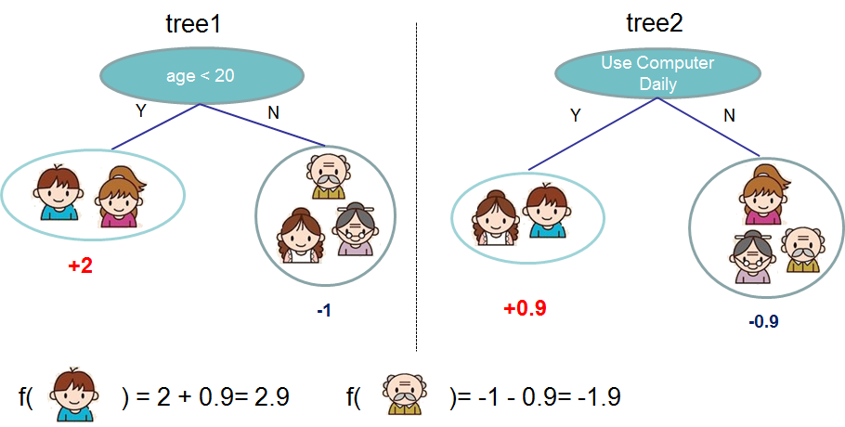
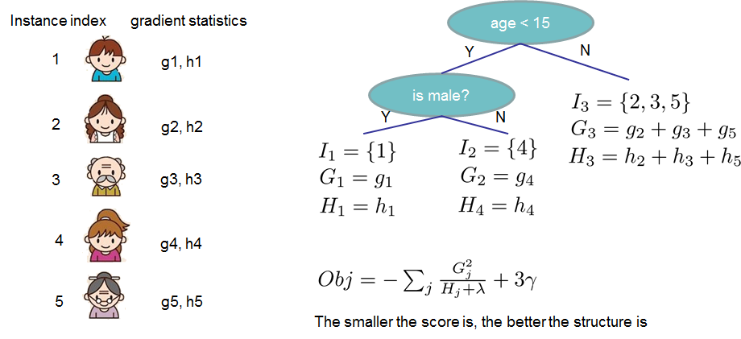
XGBoost and Gradient Boosting
Gradient Boosting:
Primarily used in classification and regression
Builds additive models in a forward stage-wise fashion
Allows for the optimization of arbitrary differentiable loss functions
Fits regression trees onto the negative gradient of the loss function
XGBoost
Supervised learning Technique
Gradient boosting decision tree ensembles
Notes:
https://xgboost.readthedocs.io/en/stable/
https://xgboost.readthedocs.io/en/stable/tutorials/model.html

Slide 7
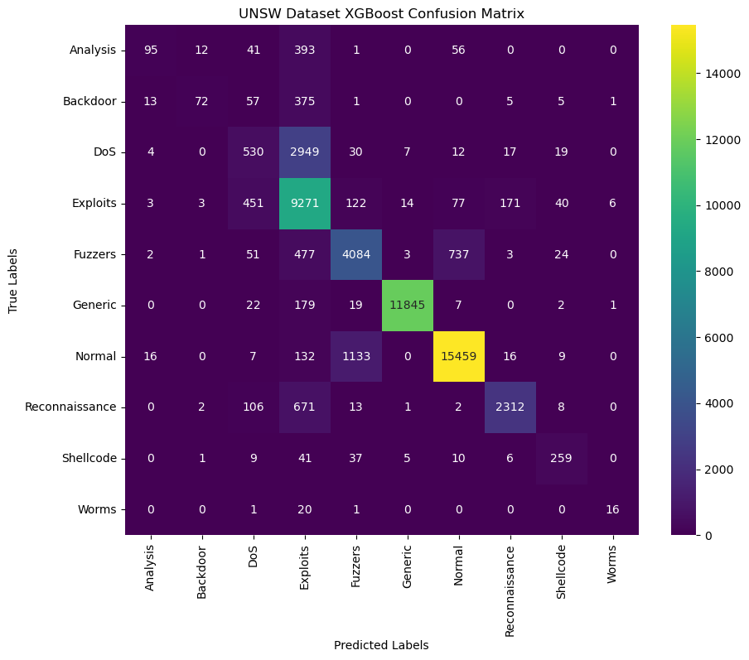
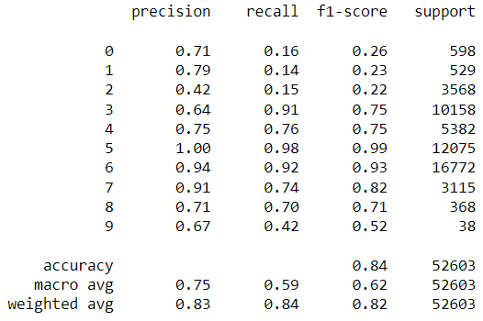
XGBoost XGBClassifier() Attack Category

Slide 8
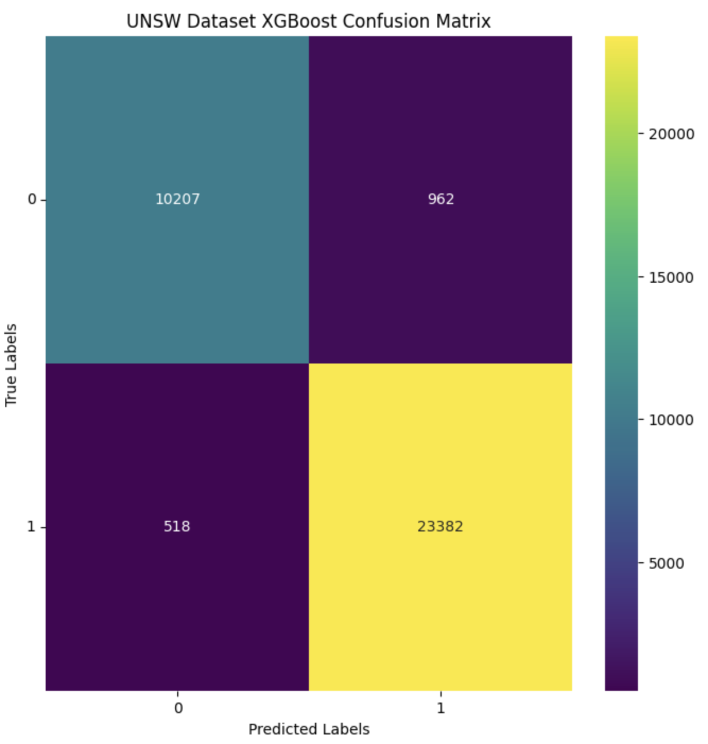
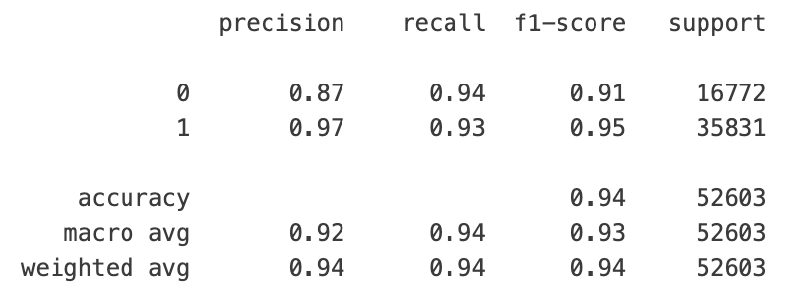
XGBoost XGBClassifier() Label

Slide 9
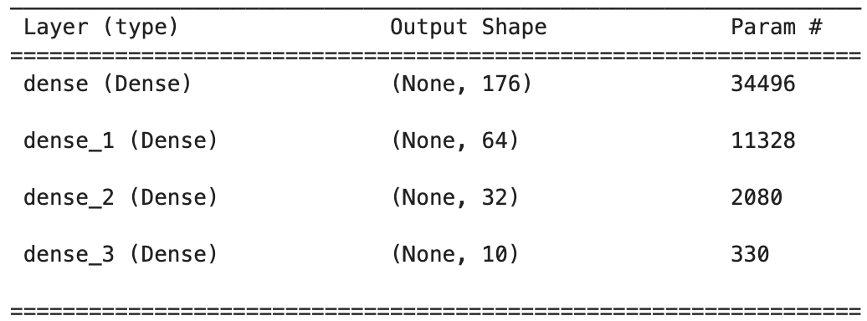
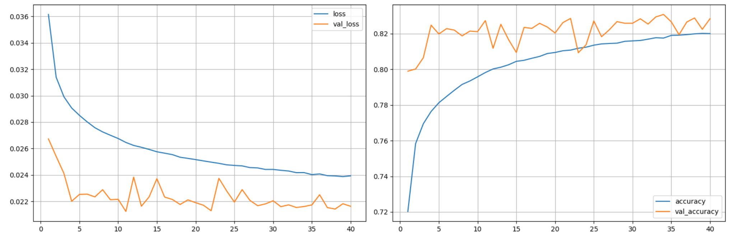
Neural Net
Train test split was 70/30
SMOTE
Notes:
https://www.spiceworks.com/tech/artificial-intelligence/articles/what-is-logistic-regression/

Slide 10
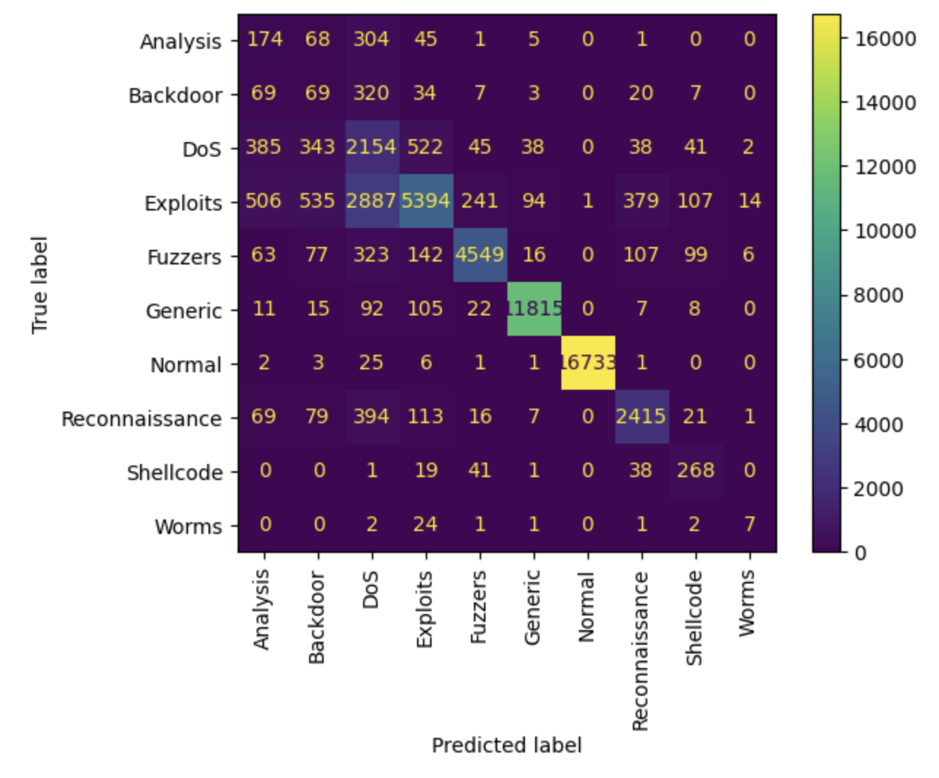
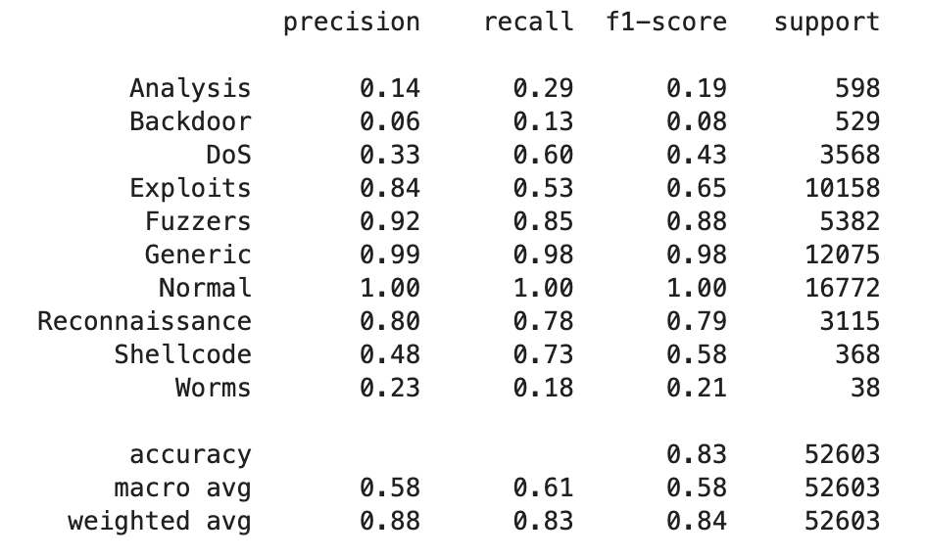
Neural Net

Slide 11
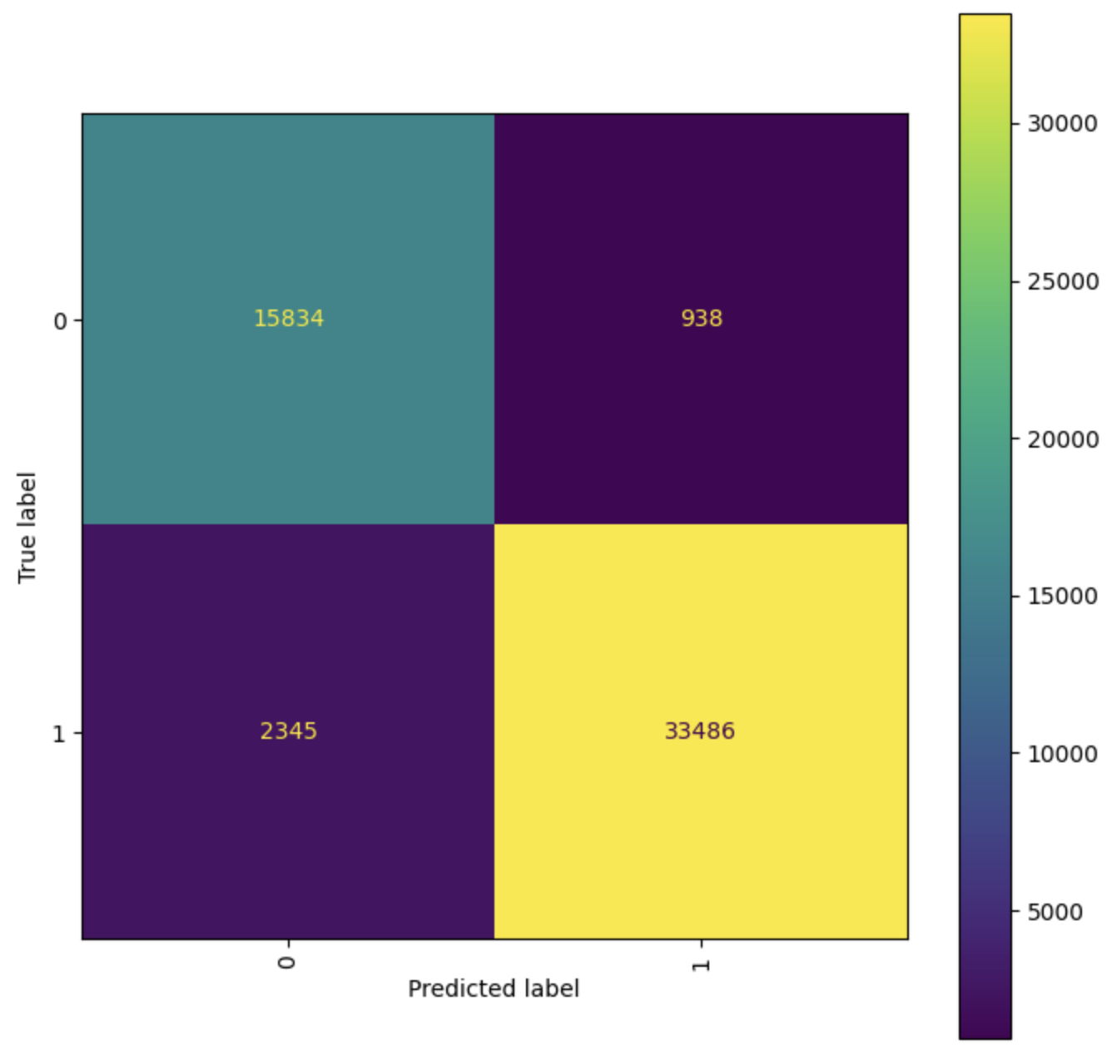
Neural Net

Slide 12
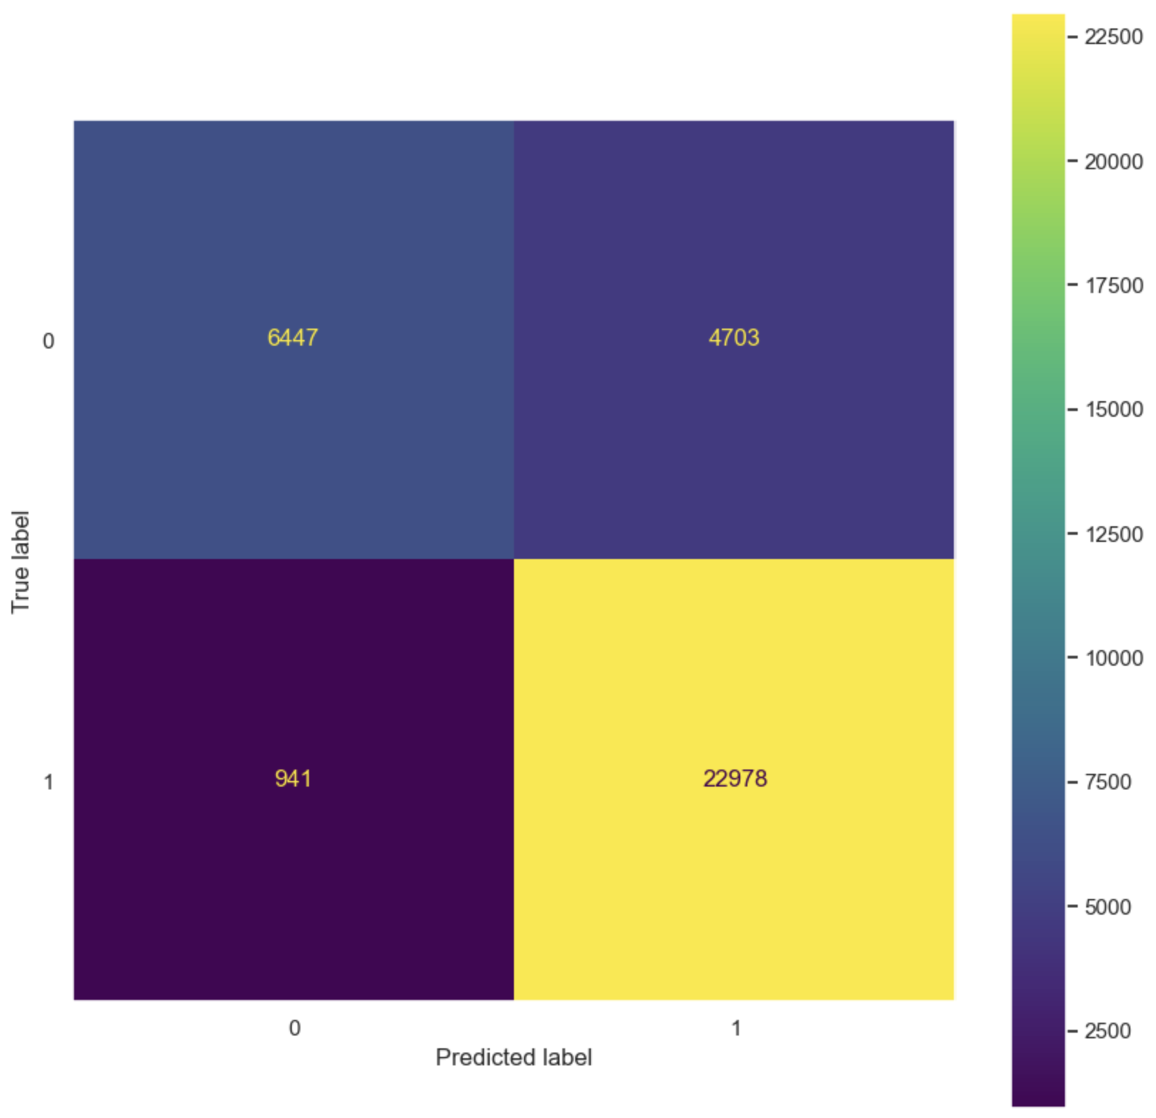
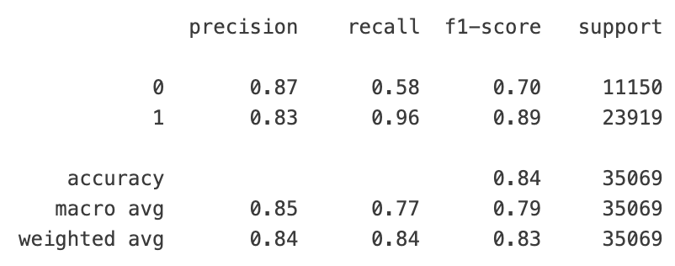
Naive Bayes

Slide 13
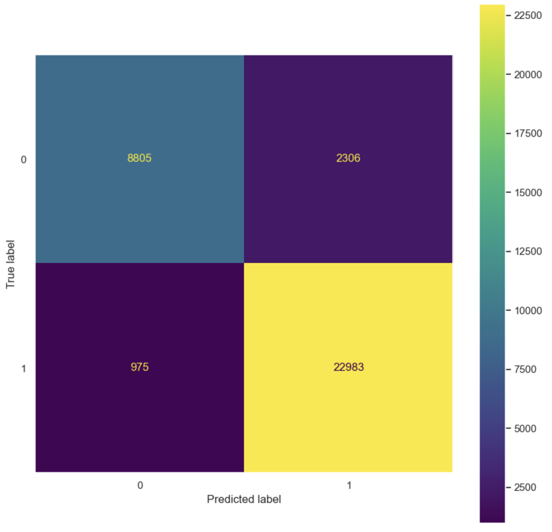
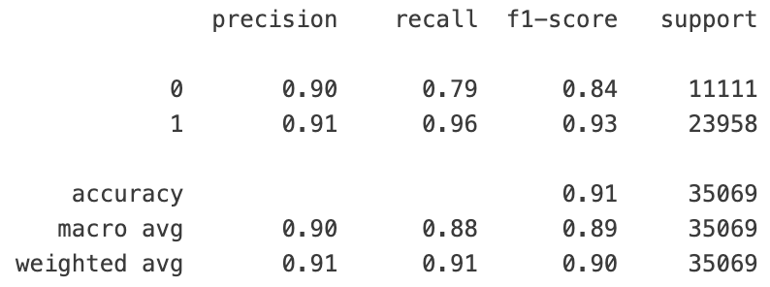
K-Nearest Neighbors

Slide 14
Cross Validated Logistic Regression
Train test split was 80/20
10 Cross Folds
One hot encoding for categorical features ended with 194 features as well as normalization after training split
Accuracy = 0.79 Precision = 0.78 Recall = 0.94 F1 = 0.86
Notes:
https://www.spiceworks.com/tech/artificial-intelligence/articles/what-is-logistic-regression/

Slide 15
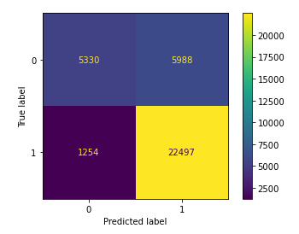
Cross Validated Logistic Regression
Binary Label
0=Normal/Benign
1=Attack/Malicious

Slide 16
Overall Results
Scores based on the binary attack/normal lable
 | F1 | Accuracy
XGBoost | 0.96 | 0.96
Logistic Regression | 0.86 | 0.79
Neural Net | 0.94 | 0.94
Naive Bayes | 0.83 | 0.84
k-Nearest Neighbors | 0.90 | 0.91

Slide 17
Conclusion
XGBoost performed best overall with predicting on a binary label additionally being able to classify attack type
K-NN and logistic regression also have the benefit of being relatively understandable models.
Neural nets require by far the most data, time, and technical knowledge to build appropriately but perform well and can generalize while asl classifying attack type
XGBoost strikes the best balance of performance, ability to generalise, and simplicity of implementation. Additionally XGBoost trained extremely fast in comparison

Slide 18
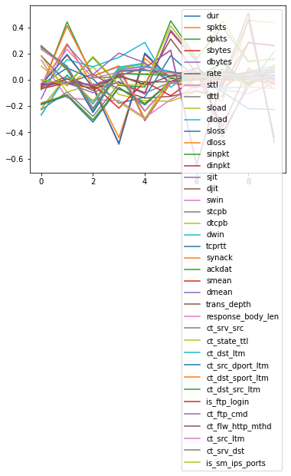
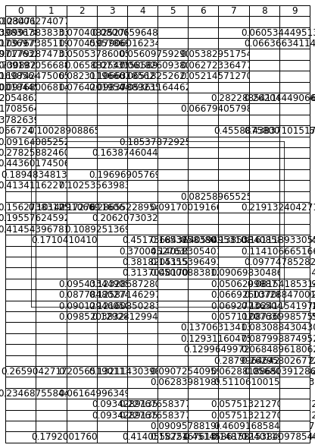
Questions
?

Slide 19
Citations
“sklearn.ensemble.GradientBoostingClassifier.” Retrieved May 23, 2023, https://scikit-learn.org/stable/modules/generated/sklearn.ensemble.GradientBoostingClassifier.html
xgboost developers. “Introduction to Boosted Trees.” Retrieved May 23, 2023, from https://xgboost.readthedocs.io/en/stable/tutorials/model.html

